Slide 1




CQRS with Erlang
presented by Bryan Hunter Firefly Logic
Twitter #erlang #cqrs
#NDCLondon
@bryan_hunter
@fireflylogic

Slide 2

University Challenge

Slide 3
?

Slide 4
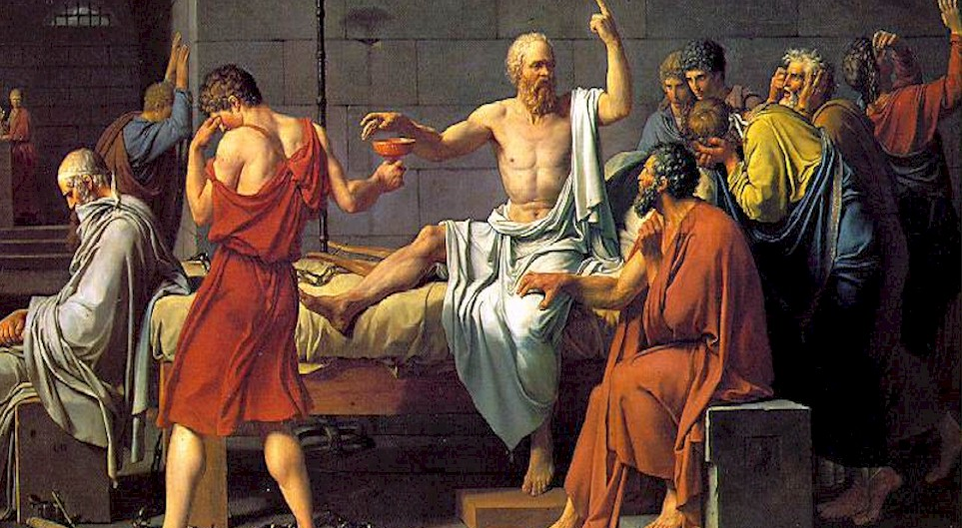

Slide 5
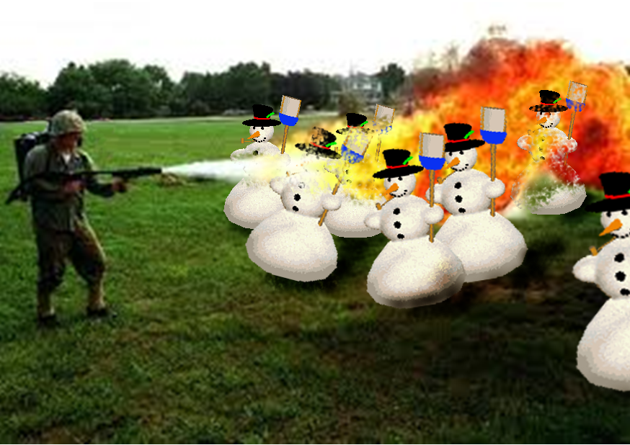
Right tool for the job!

Slide 6
What and why CQRS?

Slide 7
CQRS is Command Query Responsibility Segregation.
> What is CQRS?

Slide 8
CQRS is an architectural pattern.
> What is CQRS?

Slide 9
Command Query Separation (CQS) applied to the “big”
void MutateSomeState(…); - or - MyResult GetWithoutTouching(…);
> What is CQRS?

Slide 10
CQRS is about separating reads from writes
> What is CQRS?

Slide 11
CQRS is about heresy
> What is CQRS?

Slide 12
Why CQRS?

Slide 13

> Why CQRS?
Domain Driven Design
Your heart says “it’s the right thing”
…but your brain says “you’re a big stinkin’ fraud”

Slide 14
> Why CQRS?
Bog standard
Layered Architecture
(not CQRS)
SQL
ORM
“Aggregate”<T> ☺
Repository<T>
DTOs
Two way data binding
Client
ConcurrencyException
load()
{
this.DataSource = _service.GetData();
}
save()
{
_service.Save(this.Data); }
Notes:
TODO:

Slide 15
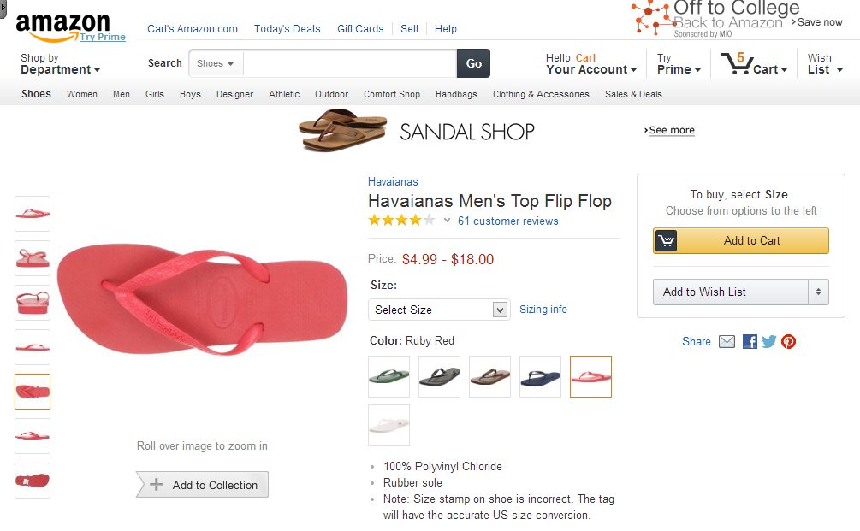
> How CQRS?
Task-based UI
Read store
Command

Slide 16
> How CQRS?
CQRS (as a cycle)
Events
Read-store
Command
Write-store
UI

Slide 17
> How CQRS?
Analytics store
CQRS (more details)
Event store
Queue
Read store
EventHandler
Event
EventHandler
EventHandler
Aggregate
Command Handler
DTO
Queue
Legacy store
Command
Client
Readonly
Command Builders
Tasks

Slide 18
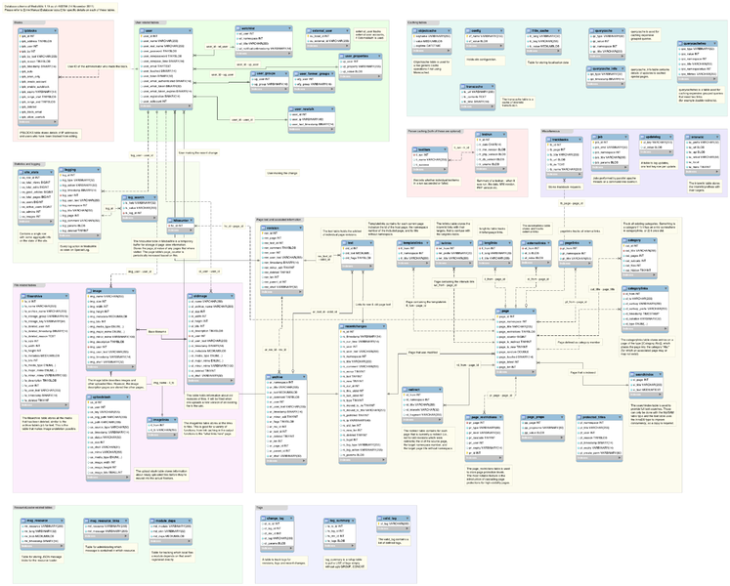
> Why CQRS?
keep your privates private

Slide 19
> Why CQRS?
CQRS
Analytics store
Event store
Queue
Legacy store
Read store
EventHandler
Event
EventHandler
Aggregate
EventHandler
Command Handler
DTO
Queue
Command
Client
Readonly
Command Builders
Tasks

Slide 20
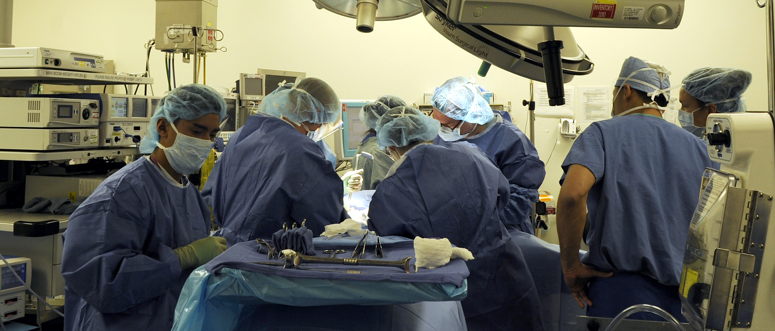
> Why CQRS?
returns focus to the business

Slide 21

> Why CQRS?
Vendor relationships should be consensual

Slide 22
> Why CQRS?
$
$
$
$
$
$
$
$
$
$
$
$
$
$
scaling up
scaling out
¢
¢
¢
¢
¢
¢
¢
¢
¢
¢

Slide 23
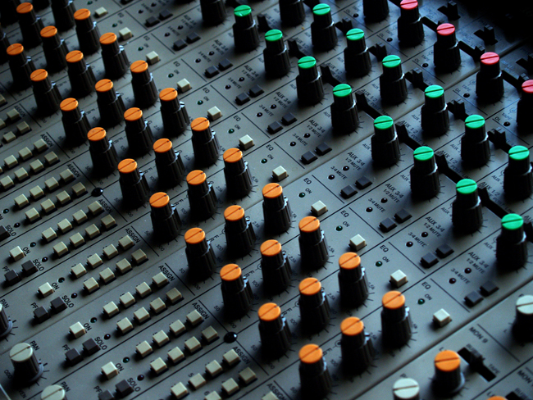
> Why CQRS?
explicit & tunable staleness

Slide 24
> Why CQRS?
Let the business tweak CAP
Partition tolerant
Consistent
Available

Slide 25
> Why CQRS?
simplify conflicts, read-write contention, and concurrency
9
0
1
2
3
4
5
6
7
8
{moved, 200203, …}
{deposited, 21203, 100}
{loanOfferSent, 200203}
{deposited, 21203, 100}
{deposited, 21203, 100}
{deposited, 200203, 1000}
{accountCreated, 21203}
{overdrafted, 200203, 50}
{withdrawn, 200203, 350}

Slide 26
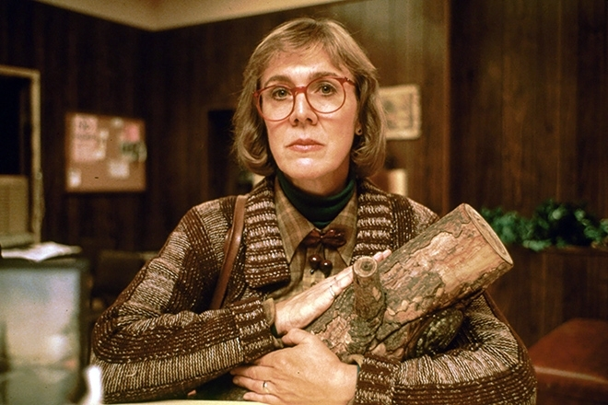
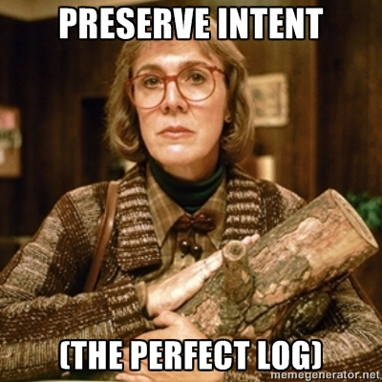
> Why CQRS?
http://memegenerator.net/Twin-Peaks-Log-Lady

Slide 27

> Why CQRS?
Our one chance to
to get it right
Big Design Upfront YAGNI Just-in-Time
Future-proof Maintenance

Slide 28
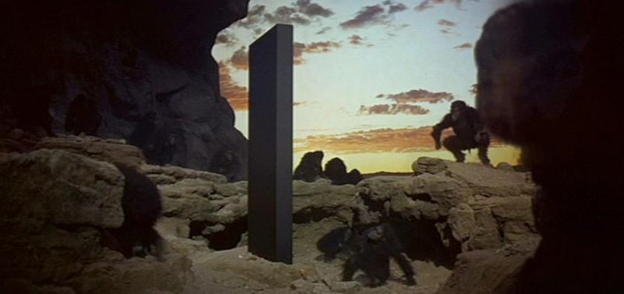
> Why CQRS?
Monoliths typically aren’t this helpful
Predictive analytics
mission-critical 24/7 3,000 TPS
Monthly batch
MVC & Entity Framework
Active-record smart-UI
Ad-hoc SQL

Slide 29
Why Erlang?

Slide 30
> Why Erlang?
Erlang is open, proven and cross-platform. It simplifies writing reliable, concurrent, distributed systems. Its pattern matching is FTW.

Slide 31
Erlang Runtime System (in-context)
.NET dev stack
Erlang dev stack
C# / F#
Erlang / Elixir / Joxa
.NET Framework
OTP
250+ years
CLR
ERTS
VM + Kernel
+ STDLIB
OS (Windows)
OS (Windows, Linux, Mac, None)

Slide 32
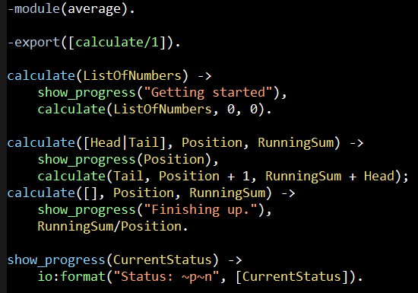
Erlang (the Language)
File: average.erl

Slide 33
“The performance
of a concurrent language
is predicated by three things:
the context switching time,
The message passing time,
and the time to create a process.”
–Mike Williams

Slide 34
One Java 6 or .NET 4.0 Thread (allocates one megabyte)
**********
**********
**********
**********
**********
**********
**********
**********
**********
**********
**********
**********
**********
**********
**********
**********
**********
**********
**********
**********
**********
**********
**********
**********
**********
**********
**********
**********
**********
**********
**********
**********
**********
**********
**********
**********
**********
**********
**********
**********
**********
**********
**********
**********
**********
**********
**********
**********
**********
**********
Heap
Mailbox
Stack
**********
**********
**********
**********
**********
**********
**********
**********
**********
**********
**********
**********
**********
**********
**********
**********
**********
**********
**********
**********
**********
**********
**********
**********
**********
**********
**********
**********
**********
**********
**********
**********
**********
**********
**********
**********
**********
**********
**********
**********
**********
**********
**********
**********
**********
**********
**********
**********
**********
**********
Garbage Collector
Links and Monitors
One Erlang Process (allocates one kilobyte)
*
Why -> elsewhere concurrency is painful

Slide 35
*
*
*
Reductions
- Do 2,000 operations
reduction1 reduction3 .
Reduction2000
- Move to the next guy - Repeat
CPU Core
Why -> near zero context switching cost

Slide 36
worker
supervisor
*
*
CPU Core
Why -> supervision

Slide 37
***** *****
***** *****
***** *****
***** *****
Core
Core
Core
Core
Why -> elsewhere concurrency is painful

Slide 38
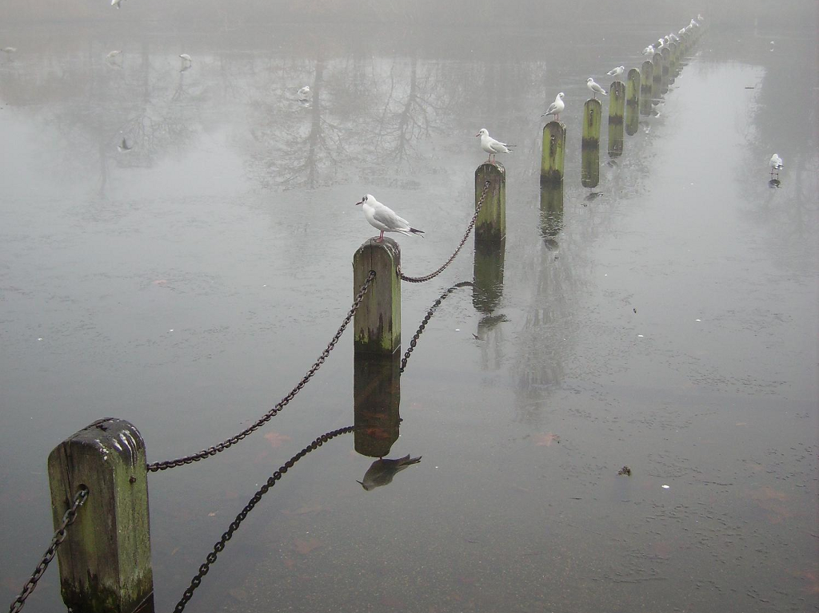
Distribution: built-in from the start

Slide 39



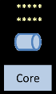
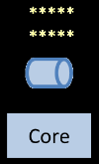
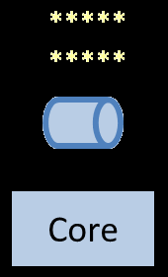
Distribution: built-in from the start

Slide 40
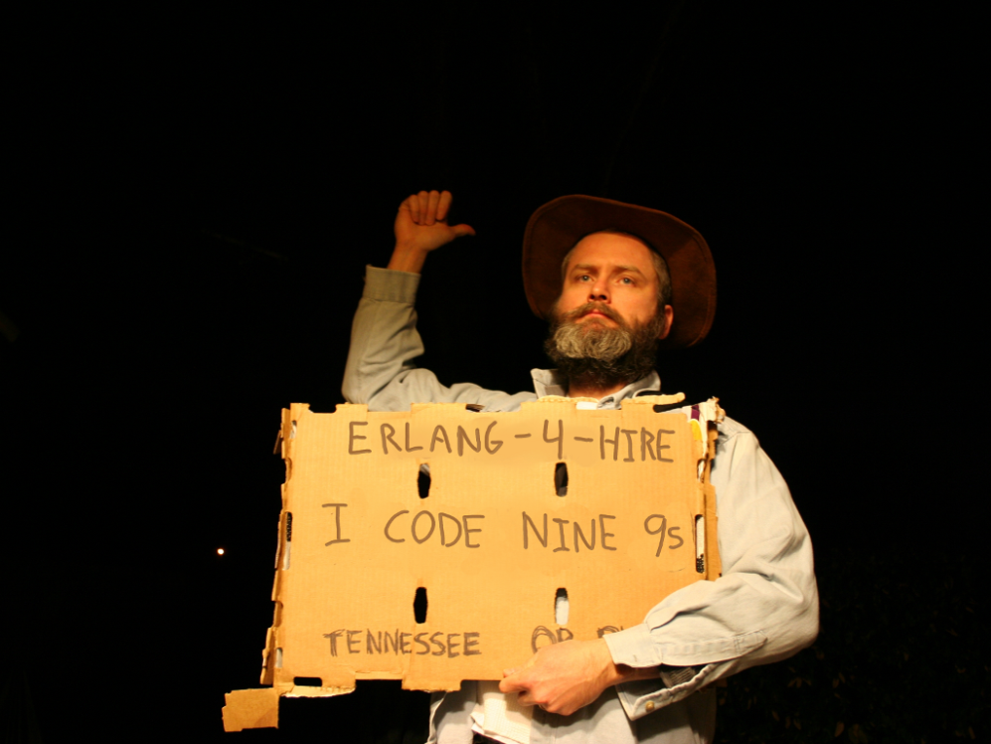
Nines | Uptime | Annual Downtime
9 | 99.9999999% | 30 milliseconds
8 | 99.9999990% | 300 milliseconds
7 | 99.9999900% | 3 seconds
6 | 99.9999000% | 32 seconds
5 | 99.9990000% | 5 minutes
4 | 99.9900000% | 53 minutes
3 | 99.9000000% | 8 hours, 46 minutes
2 | 99.0000000% | 3 days, 15 hours, 36 minutes
Safe
Supervisor
Worker
Worker
Links and monitors
No masters
Hot code loading
simple distribution, safe concurrency
Why -> reliability

Slide 41
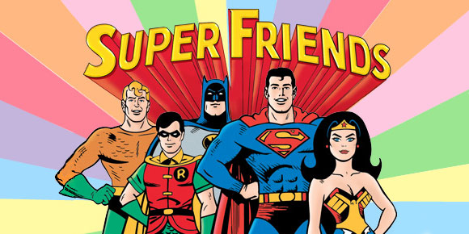
[insert awe inspiring demo here]
Notes:
http://www.dccomics.com/tv/super-friends-1973-1974

Slide 42













When you reach for CQRS you are solving problems that led these companies
to
…to

Slide 43
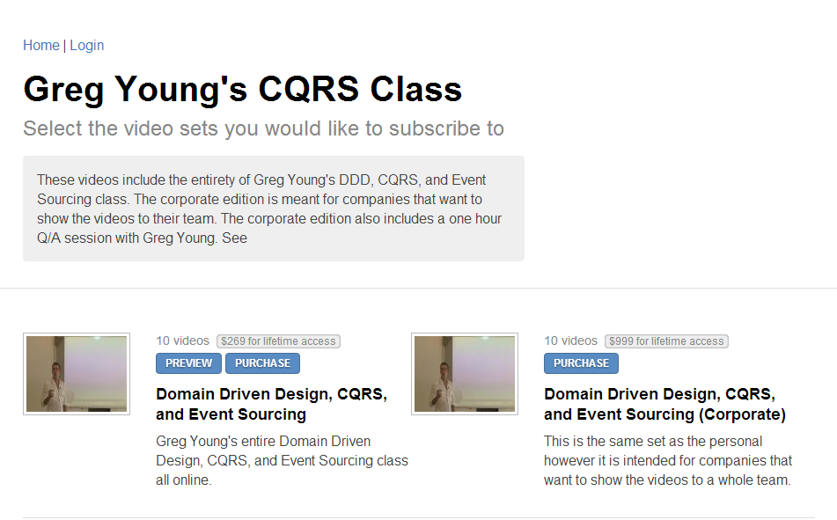

http://subscriptions.viddler.com/GregYoung
How -> watch some videos

Slide 44
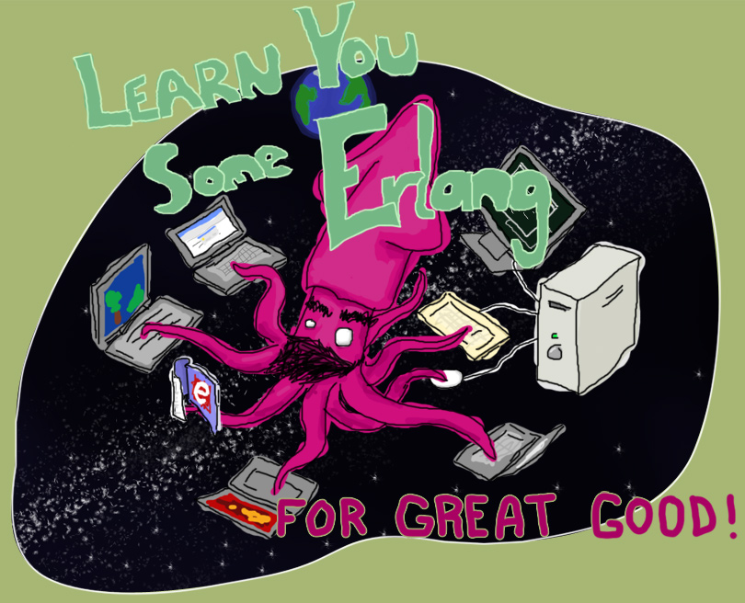
“Learn You Some Erlang for Great Good!” http://learnyousomeerlang.com/
How -> read this excellent and free online book

Slide 45



Start here
How -> read some books

Slide 46
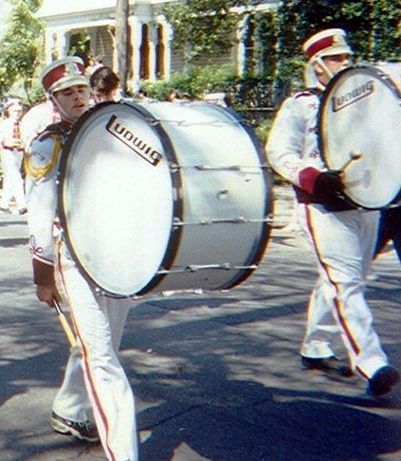


Start a polyglot FP group
http://nashfp.org
How -> Better yet; pack up and move to Nashville!

Slide 47
Thanks!
Bryan Hunter
Twitter: @bryan_hunter
Email: bryan.hunter@fireflylogic.com
Firefly Logic, Inc.
1000 Main Street #201 Nashville, TN 37206
http://fireflylogic.com
> keep in touch

